Slide 1


Dept of ECE

Slide 2


Slide 3
Shrusti Slides

Slide 4

Dept of ECE

Slide 5
Rahul Slides

Slide 6
Overview of Pulp & Paper Industry Waste
Types of Waste Generated
Wastewater: Washing, pulping, bleaching.
Solid Waste: Handling, screening, sludge.
Air Emissions: Sulfur, SO₂, NOx.
Environmental Impact
Water: Pollution.
Soil: Contamination.
Air: Degradation.
Dept of ECE

Slide 7
Waste Audit Procedures
Wastewater Treatment Analysis
Primary: Clarifiers.
Biological: Aeration, sludge.
Segregation: Targeted.
Solid Waste Management
Reuse: Recycling.
Sludge: Dewatering.
Dept of ECE

Slide 8
Pollution Prevention Opportunities
Process Optimization
Water: Recycling.
Bleaching: Recirculation.
Housekeeping: Efficient.
Chemical Recovery Techniques
Black Liquor: Recovery.
Relime: Reuse.
Lime: Optimization.
Dept of ECE

Slide 9
Pollution Prevention Opportunities
Use of Alternative Raw Materials
Bagasse: Renewable.
Enzymes: Biodegradable.
Recycling: Fibers.
Dept of ECE

Slide 10
Waste Audits in the Electroplating Industry
Overview of Electroplating Industry Waste
Types: Cyanide, chromium, cadmium, solvents, sludges.
Impact: Groundwater, air, and soil contamination.
Waste Audit Procedures
Chemical Usage: Evaluate inefficiencies.
Wastewater: Analyze pollutants.
Pollution Prevention Opportunities
Process Modification: Optimize systems.
Recovery & Recycling: Reuse chemicals.
Non-toxic Alternatives: Safer substitutes.
Dept of ECE

Slide 11
Rakshita Slides

Slide 12
Dept of ECE

Slide 13
Kavya Slides

Slide 14
Dept of ECE

Slide 15
Anish Slides

Slide 16

Definition and Importance of Transboundary Movement of Hazardous Wastes
Definition: Transportation of hazardous waste across international borders for disposal, recycling, or treatment.
Importance:
Environmental Protection: Prevents pollution and protects ecosystems.
Public Health: Reduces health risks from toxic exposure.
Global Responsibility: Shared duty for sustainable waste management.
Economic Considerations: Avoids costly clean-up and legal liabilities.
Dept of ECE

Slide 17

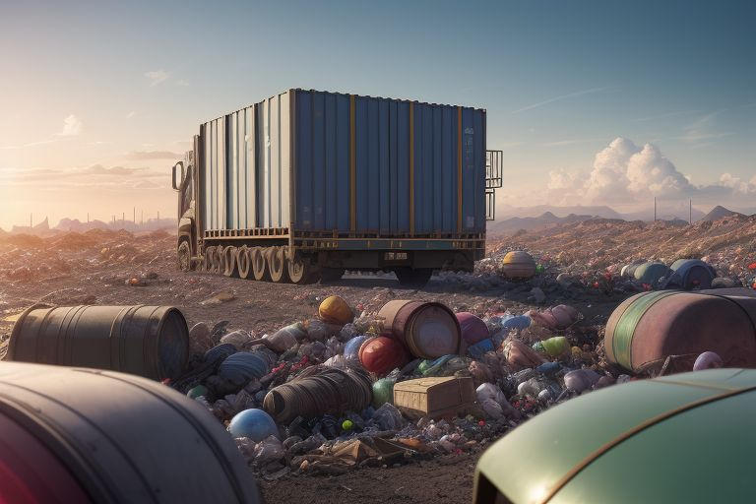
Regulations Governing Transboundary Movement
Basel Convention: Key treaty to reduce hazardous waste movement, requiring prior informed consent.
EU Waste Shipment Regulation: Governs waste movement within/outside the EU, ensuring environmentally sound management.
National Regulations: Countries have specific laws complementing international treaties.
Dept of ECE

Slide 18

Procedures for Compliance
Notification and Consent: Exporters must notify authorities and obtain consent from importing countries.
Documentation: Essential records include waste manifests and contracts.
Tracking and Reporting: Movement must be tracked and reported to ensure compliance.
Compliance with Destination Regulations: Ensure waste meets importing country standards.
Dept of ECE

Slide 19

Case Studies and Examples
Basel Convention Case: Illegal export of hazardous waste from the U.S. to Africa highlighted enforcement needs.
EU Waste Shipment Regulation Example: Legal actions against a member state for improper waste export.
E-Waste Trade: Significant issue with improper management leading to environmental and health impacts.
Dept of ECE

Slide 20

Overview of Disposal Methods
Landfill Disposal: Containment in engineered landfills; requires monitoring and strict regulations.
Incineration: High-temperature burning to reduce volume and toxicity; requires emission control.
Recycling and Recovery: Processing to reclaim resources; must comply with safety regulations.
Dept of ECE

Slide 21

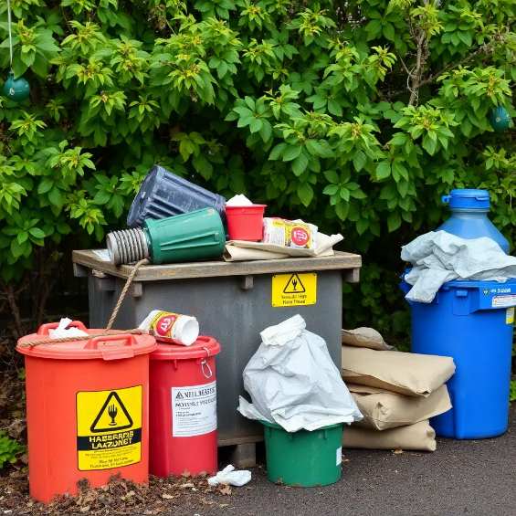
Best Practices for Hazardous Waste Disposal
Characterization: Identify waste composition and hazards.
Segregation: Separate hazardous from non-hazardous waste.
Documentation: Maintain thorough records for compliance.
Training: Educate personnel on safe handling and disposal.
Emergency Preparedness: Implement response plans for spills or accidents.
Dept of ECE

Slide 22
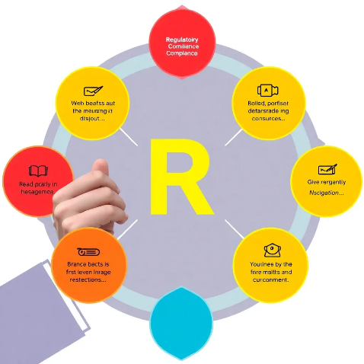
Regulatory Compliance and Standards
Overview: Compliance is essential for safe hazardous waste disposal.
Key Regulations:
RCRA: Governs hazardous waste management in the U.S.
Basel Convention: Regulates transboundary waste movement.
EU Waste Framework Directive: Sets waste management principles in the EU.
Compliance Requirements: Labeling, storage, disposal, and reporting standards.
Dept of ECE

Slide 23

Conclusion
Summary of Key Points: Effective disposal is crucial for health and environmental protection.
Importance of Waste Audits: Identify improvements and promote sustainability.
Call to Action for Industries: Develop comprehensive waste management plans and adopt pollution prevention measures.
Dept of ECE

Slide 24

Dept of ECE

Slide 25
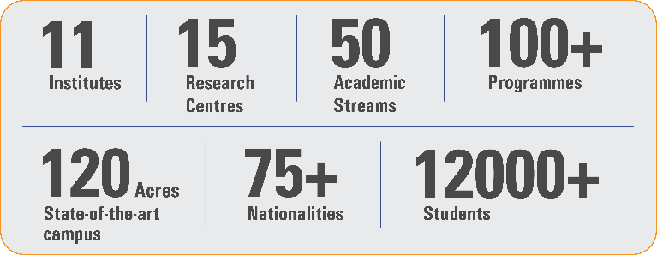
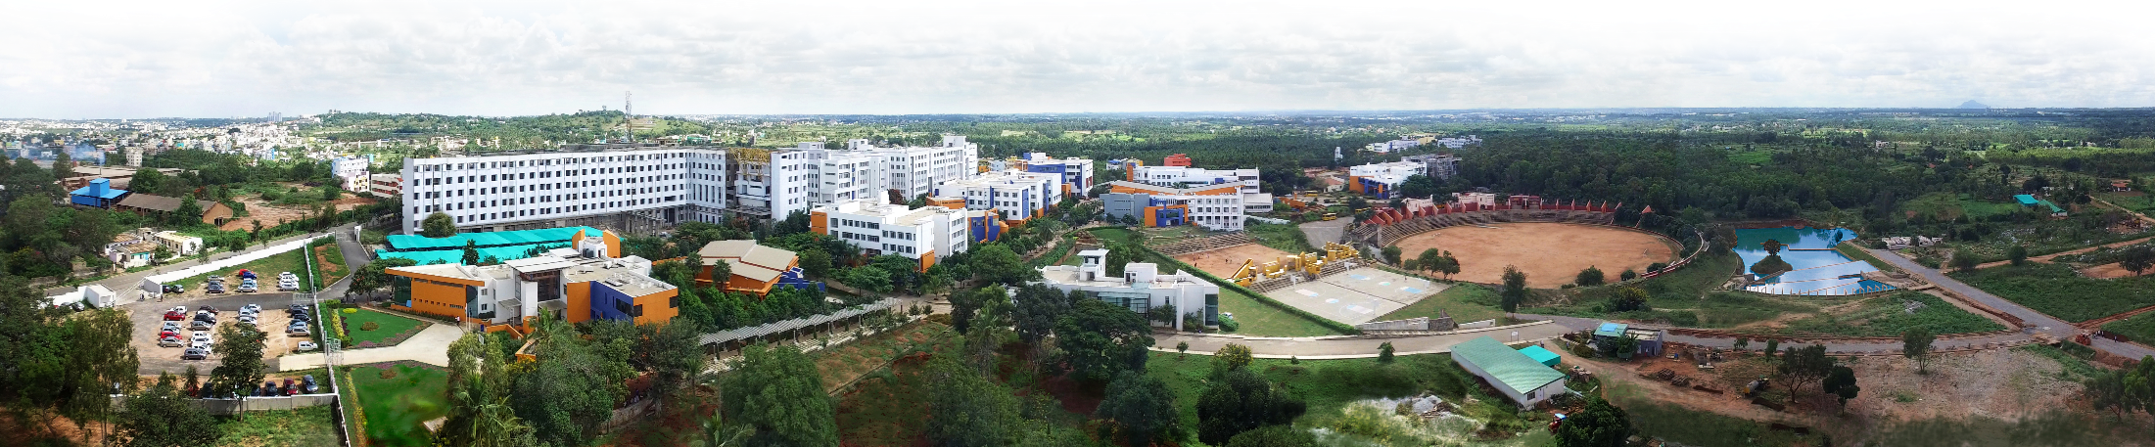
Overveiw
Acharya stands as a beacon of excellence in higher education, boasting a legacy of academic distinction since its establishment in 1990. We offer a transformative educational experience, fostering holistic development, nurturing innovation and providing world-class facilities to ensure an enriching journey for our students.
Dept of ECE

Slide 26

11 Institutions, Infinite Possibilities
We provide 100+ programs across 50 academic streams.
Dept of ECE

